Slide 1
Ethics in information technology
Lecture Slide#1

Slide 2
Introduction
Course code: SE511
Title: Professional Ethics for Information Systems
(2 credit theory + 1 credit lab)
Continuous Evaluation: 50% (attendance/quizzes/assignments/presentations/mid-term/in-course exam/lab works)
Final exam:50%
Reference Book
ETHICS IN INFORMATION TECHNOLOGY (5th Edition)
By: George W. Reynolds

Slide 3
Virtue and Vice
A virtue is a habit that inclines people to do what is acceptable (e.g., fairness, generosity, and loyalty), and a vice is a habit of unacceptable behavior (e.g., greed, envy, and anger).
Virtues are like habits; that is, once acquired, they become characteristics of a person. The virtuous person is the ethical person.

Slide 4
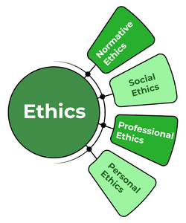
What is Ethics?
Ethics is a branch of philosophy that is concerned with human conduct, more specifically the behaviour of individuals in society.
Ethics/moral philosophy is a set of beliefs about right and wrong behavior within a society.
Ethical behavior conforms to generally accepted norms—many of which are almost universal.

Slide 5
What is Ethics?
Sociologist Raymond Baumhart asked business people, "What does ethics mean to you?" Among their replies were the following:
"Ethics has to do with what my feelings tell me is right or wrong.“
"Ethics has to do with my religious beliefs.“
"Being ethical is doing what the law requires.“
"Ethics consists of the standards of behavior our society accepts.“
"I don't know what the word means."

Slide 6
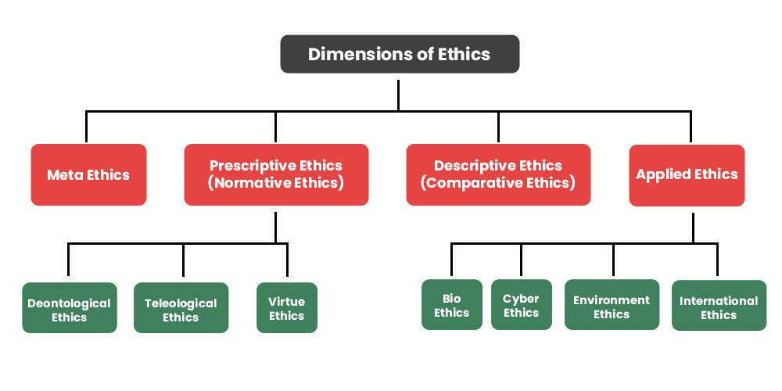
Dimensions of Ethics

Slide 7
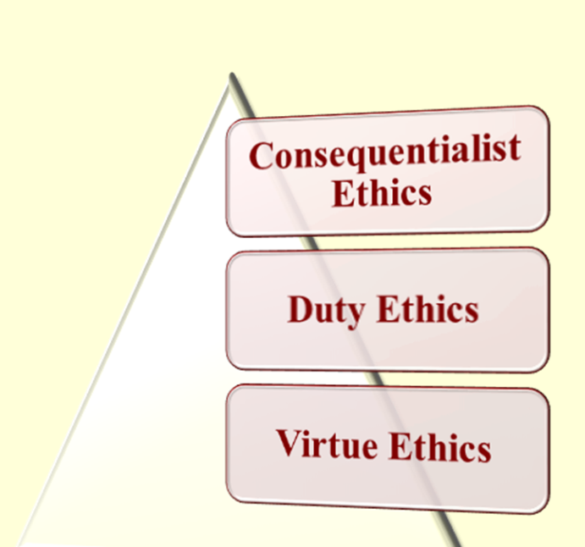
Normative Ethics
Normative ethics is the study of ethical behaviour and is also known as moral philosophy. It covers the right and wrong of human conduct and the good and bad of a human character.
Three main types of Normative ethical theories: Consequentialist, Duty, and Virtue Ethics

Slide 8
Consequentialist Ethics
The morality of an action is determined by its consequences
The ends justify the means
Right actions lead to good consequences Wrong actions lead to bad consequences
But good or bad consequences for whom?
Is stealing right or wrong?

Slide 9
Some Forms of Consequentialism
Utilitarianism holds that an action is right if it leads to the most happiness for the greatest number of people.
Hedonism is a type of consequentialism that states that the pursuit of pleasure should be the highest moral priority.
Rule consequentialism holds that rules should be written regarding their likely outcomes, not necessarily on their inherent good or bad nature.
State consequentialism, or Mohist consequentialism, holds that an action is right if it leads to state welfare, through order, material wealth, and population growth.

Slide 10
Criticism of Consequentialism
We do not know the future
In some situations, consequentialism may lead to decisions that are objectionable even though the consequence are arguably good.

Slide 11
Duty-based or Deontological ethics
Deontology is an ethical theory that says actions are good or bad according to a clear set of rules.
Duty ethics provides a clear and principled approach to ethics
Individuals have a moral duty to follow certain universal principles and rules, regardless of the consequences
It has been criticized for being too rigid and inflexible, especially when faced with moral dilemmas where adherence to a specific rule may lead to morally questionable outcomes.

Slide 12
Virtue ethics
It treats virtue and character as the primary subjects of ethics
It emphasizes the role of character and virtue in moral philosophy rather than either doing one’s duty or acting to bring about good consequences.
A virtue ethicist is likely to give you this kind of moral advice: “Act as a virtuous person would act in your situation.”

Slide 13
The Difference Between Morals, Ethics, and Laws
Morals are one’s personal beliefs about right and wrong
Ethics describes standards or codes of behavior expected of an individual by a group (nation, organization, profession) to which an individual belongs.
For example, the ethics of the law profession demand that defense attorneys defend an accused client to the best of their ability, even if they know that the client is guilty of the most heinous and morally objectionable crime one could imagine.
Law is a system of rules that tells us what we can and cannot do. Laws are enforced by a set of institutions (the police, courts, and law-making bodies).
Legal acts are acts that conform to the law. Laws can proclaim an act as legal, although many people may consider the act immoral—for example, abortion. Legal acts are subjective.

Slide 14
Ethics in Business World
Ethics has risen to the top of the business agenda because the risks associated with inappropriate behavior have increased, both in their likelihood and their potential negative impact.
It is not unusual for powerful, highly successful individuals to fail to act in morally appropriate ways
The moral corruption of people in power, which is often facilitated by a tendency for people to look the other way when their leaders act inappropriately has been given the name Bathsheba syndrome.

Slide 15
Most Common forms of Employee Misconduct
Please visit
https://www.ethics.org/

Slide 16
Conflict of Interest
A conflict of interest occurs when an entity or individual becomes unreliable because of a clash between personal (or self-serving) interests and professional duties or responsibilities.
A situation in which someone cannot make a fair decision because they will be affected by the result
Example:
I need to declare a conflict of interest here - one of the candidates for the job is a friend of mine.

Slide 17
Conflict of Interest
Example:
Representing a family member in court
Advising a client to invest in a company owned by your spouse
Hiring an unqualified relative or friend
A conflict of interest in research can be defined as a situation in which an individual has “interests in the outcome of the research that may lead to a personal advantage.
An academic who has a senior editorial position with a commercial journal is also on a University library committee that recommends journal subscriptions
The researcher conducts a clinical trial which is sponsored by any person or organisation with a significant interest in the results of the trial.
In the peer review and publication process, an author, reviewer or editor allows personal conviction, financial interests, or personal views (of amity or enmity) to influence the work improperly.
What about our doctors and medical representatives?

Slide 18
Corporate Social Responsibility
Corporate social responsibility (CSR) is the concept that an organization should act ethically by taking responsibility for the impact of its actions on the environment, the community, and the welfare of its employees
Setting CSR goals encourages an organization to achieve higher moral and ethical standards.
Supply chain sustainability is a component of CSR that focuses on developing and maintaining a supply chain that meets the needs of the present without compromising the ability of future generations to meet their needs.
Supply chain sustainability takes into account such issues as fair labor practices, energy and resource conservation, human rights, and community responsibility.

Slide 19
Types of Corporate Social Responsibility
Environmental Responsibility
Reducing pollution, waste, natural resource consumption, and emissions through its manufacturing process.
Recycling goods and materials
Ethical Responsibility
Fair treatment across all types of customers regardless of age, race, culture, or sexual orientation.
Positive treatment of all employees including favorable pay and benefits in excess of mandated minimums.
Philanthropic Responsibility
Whether a company donates the profit to charities or causes it believes in.
Whether a company supports employee philanthropic endeavors through time off or matching contributions.

Slide 20
Fostering Corporate Social Responsibility and Good Business Ethics
Organizations have at least five good reasons for pursuing CSR goals and for promoting a work environment
Gaining the goodwill of the community
Creating an organization that operates consistently
Fostering good business practices
Protecting the organization and its employees from legal action
Avoiding unfavorable publicity

Slide 21
Examples of IT organizations’ socially responsible activities

Slide 22
Improving Corporate Ethics
Some of the following actions corporations can take to improve business ethics
Appointing a Corporate Ethics Officer
Ethical Standards Set by Board of Directors
Establishing a Corporate Code of Ethics
Conducting Social Audits
Requiring Employees to Take Ethics Training
Including Ethical Criteria in Employee Appraisals

Slide 23
Approaches for Ethical Decision Making
The Utilitarian Approach
The ethical action is the one that provides the greatest good for the greatest number.
To analyze an issue using the utilitarian approach, we first identify the various courses of action available to us. Second, we ask who will be affected by each action and what benefits or harms will be derived from each. And third, we choose the action that will produce the greatest benefits and the least harm
The Virtue Approach
The virtuous person is the ethical person. Honesty, courage, compassion, generosity, fidelity, integrity, fairness, self-control, and prudence are examples of virtues frequently cited throughout the world. This approach focuses on attitudes, dispositions, or character traits that enable us to be and to act in ways that develop our human potential.

Slide 24
Approaches for Ethical Decision Making
The Fairness (or Justice) Approach
Greek philosopher Aristotle, who said that “equals should be treated equally and unequals unequally.” The basic moral question in this approach is: How fair is an action? Does it treat everyone in the same way, or does it show favoritism and discrimination?
“Treat people the same unless there are morally relevant differences between them.”
The Common Good Approach
In this approach, we focus on ensuring that the social policies, social systems, institutions, and environments on which we depend are beneficial to all. Examples of goods common to all include affordable health care, effective public safety, peace among nations, a just legal system, and an unpolluted environment.
This ethical choice advances the common good.

Slide 25
Approaches for Ethical Decision Making
The Rights Approach
The basic idea here is that people have a right to be treated with respect and dignity.
The right to the truth: We have a right to be told the truth and to be informed about matters that significantly affect our choices.
The right of privacy: We have the right to do, believe, and say whatever we choose in our personal lives so long as we do not violate the rights of others.
The right not to be injured: We have the right not to be harmed or injured unless we freely and knowingly do something to deserve punishment or we freely and knowingly choose to risk such injuries.
The right to what is agreed: We have a right to what has been promised by those with whom we have freely entered into a contract or agreement.

Slide 26
Approaches for ethical decision making

Slide 27
IT Professional
A profession is a calling that requires
Specialized knowledge
Long and intensive academic preparation.
Professionals:
Require advanced training and experience
Must exercise discretion and judgment in their work
Cannot standardize their work
Carry special rights and responsibilities.

Slide 28
IT Professional
In other words, professionals such as doctors, lawyers, and accountants require advanced training and experience; they must exercise discretion and judgment in the course of their work, and their work cannot be standardized.

Slide 29
IT Workers Professionals?
A partial list of IT specialists
IT specialists include programmers,
Systems analysts,
Software engineers,
Database administrators,
Local area network (LAN) administrators
Chief information officers (CIOs)
Many business workers have duties, backgrounds, and training that qualify them to be classified as professionals, including marketing analysts, financial consultants, and IT specialists such as mobile application developers, software engineers, systems analysts, and network administrators.
One could argue, however, that not every IT role requires “knowledge of an advanced type in a field of science or learning customarily acquired by a prolonged course of specialized intellectual instruction and study
From a legal perspective, IT workers are not recognized as professionals
They are not licensed by the state or federal government

Slide 30
Professional Codes of Ethics
A professional code of ethics states the principles and core values that are essential to the work of a particular occupational group. Practitioners in many professions subscribe to a code of ethics that governs their behavior.
An important point to make is that laws do not provide a complete guide to ethical behavior. Just because an activity is not defined as illegal does not mean it is ethical.

Slide 31
Professional Codes of Ethics
Benefits individual, profession, and society as a whole:
Ethical decision making
High standards of practice and ethical behavior
Trust and respect from the general public
Evaluation benchmark for self-assessment
No universal code of ethics for IT workers.
some organizations: ACM(Association for Computing Machinery),
IEEE-CS(IEEE-Computer Society),
AIPS (Association of Information Technology Professionals),
SANS (SysAdmin, Audit, Network, Security Institute)

Slide 32
Relation Between IT workers and IT users
The term IT user distinguished the person who uses a hardware or software product from the IT workers who develop, install, service, and support the product
IT users need the product to deliver organizational benefits or to increase their productivity
IT workers have a duty to understand a user’s needs and capabilities and to deliver products and services that best meet those needs.

Slide 33
Some Ethical Issues in IT
Software piracy / Access right
Misuse of Personal Information / Personal Privacy: Companies often gather information to hyper-personalize our online experiences, but to what extent is that information actually impeding our right to privacy?
Misinformation and Deep Fakes
Use of AI
Facial recognition
Replacement of human jobs
Health tracking
Bias in AI technology
Inappropriate use of computing resources
Inappropriate sharing of information

Slide 34
Supporting the Ethical Practices of IT Users
Establishing guidelines for use of company software
Defining the appropriate use of IT resources
Structuring information systems to protect data and information
Installing and maintaining a corporate firewall
Respect for Employees and Customers
Moral Use of Data and Resources
Create a Culture of Responsibility

Slide 35
Some Important Terminologies
Trade Secret is information, generally unknown to the public, that has economic value and the company has taken strong measures to keep confidential.
Patents: A patent can preserve the unique and secret aspect of an idea. Obtaining a patent is very difficult as compared with obtaining a copyright. A thorough disclosure is required with the software. The patent holder has to reveal the full details of a program to a proficient programmer for building a program.
Copyright: Copyright law automatically protects original works of authorship, such as books, articles, songs, photographs, sculptures, choreography, sound recordings, motion pictures, and other works.
A patent protects new inventions, processes, or scientific creations, a trademark protects brands, logos, and slogans, and a copyright protects original works of authorship.

Slide 36
Some Important Terminologies
Whistle Blowing is an effort by an employee to attract attention to a negligent, illegal, unethical, abusive, or dangerous act by a company that threatens the public interest.
Fraud is the crime of obtaining goods, services, or property through deception or trickery
Misrepresentation is the misstatement or incomplete statement of a material fact
Breach of contract occurs when one party fails to meet the terms of a contract
Bribery involves providing money, property, or favors to someone in business or government to obtain a business advantage.
What are the differences between gifts and bribery?

Slide 37
What are the abnormalities in this lecture slide??

Slide 38
Assignment
Task#1: Make groups of maximum 4 students and carefully solve the discussion questions of Chapter 1 and Chapter 2 of your referenced text book (Ethics in Information Technology).
Task#2: Carefully read and analyze the situations described in the section What Would You Do in chapters 1 and 2. Select any 4 situation randomly, make a PowerPoint presentation recommending a course of action for each individual situation you selected. You have to present your opinion in the next scheduled class.

